Slide 1


7:00
Thursday, December 26
7:00 PM
12/26/2024

Slide 2

DEPI-Group4
SIGN IN

Slide 3




Introduction
MEMBERS
Amr Khaled Mariam Hassan
Rana
Logi Malik
REPORT TITLE
E-commerce Data Analysis
Objectives
Codes
Pictures
Insert Topic Title
7:00 PM
12/26/2024

Slide 4
x
This presentation is about using SQL to study E-commerce Data.
We will look at the number of orders, prices, product categories, sales predictions, linear regression, and order delivery. The goal is to find useful insights to improve business.
INTRODUCTION
Introduction
Objectives
Codes
Pictures
Insert Topic Title
7:00 PM
12/26/2024

Slide 5

OBJECTIVES
x
Introduction
Number of orders: Track and analyze order volumes.
Order prices: Examine pricing trends and patterns.
Product categories: Assess category performance and profitability.
Sales prediction: Forecast future sales based on historical data.
Linear regression: Apply regression models to support predictions.
Order delivery: Analyze delivery timelines and improve logistics.
Objectives
Codes
Pictures
Insert Topic Title
7:00 PM
12/26/2024

Slide 6
Codes
x
Introduction
Code 1
Code 2
Code 3
Code 4
Code 5
Objectives
Codes
Pictures
Insert Topic Title
7:00 PM
12/26/2024

Slide 7
Codes
x
Introduction
Code 1
Code 2
Code 3
Code 4
Code 5
Objectives
x
Code 1
1-Database Setup
2-Exploring the orders Table
3-Analyzing Daily Orders
4-Analyzing Orders by Day of the Week and Hour
5-Analyzed customer distribution based on city and state
Codes
Pictures
Insert Topic Title
7:00 PM
12/26/2024

Slide 8
Codes
x
Introduction
Code 1
Code 2
Code 3
Code 4
Code 5
Objectives
x
Code 2
1- Show table order_items
2- show table of product cost and freight value
3- calculate maximum, minimum and average of prices
4- visualize the product costs and shipping cost
Codes
Pictures
Insert Topic Title
7:00 PM
12/26/2024

Slide 9
Codes
x
Introduction
Code 1
Code 2
Code 3
Code 4
Code 5
Objectives
x
Code 3
1- display table of the most selling categories and rank them by sales
2- display the first 18 categories with their sales and merge the other giving name of other categories with the sum of their sales together
3-store the first 18 categories in tuple
4- create a table to order the categories according their weights and order their rows also count their total number of rows
5- calculate median of each catagory and rank them according to their weights
Codes
Pictures
Insert Topic Title
7:00 PM
12/26/2024

Slide 10
Codes
x
Introduction
Code 1
Code 2
Code 3
Code 4
Code 5
Objectives
x
Code 4
1-predict sales for each category from date january1 2017 to august 8 2018
2-plotting sales for categories ,monthly sales on y axis and year -month on axis
Codes
Pictures
Insert Topic Title
7:00 PM
12/26/2024

Slide 11
Codes
x
Introduction
Code 1
Code 2
Code 3
Code 4
Code 5
Objectives
x
Code 5
Purpose: Analyzes the order delivery stages and calculates average durations for different stages of order processing for each city.
SQL Query Details: 1- Data Aggregation
2- Grouping
3- Sorting
4- Python Code
5- Output : The resulting DataFrame (df) contains average delivery stage times for cities, sorted by the cities with the longest combined processing times.
Topics
Pictures
Insert Topic Title
7:00 PM
12/26/2024

Slide 12
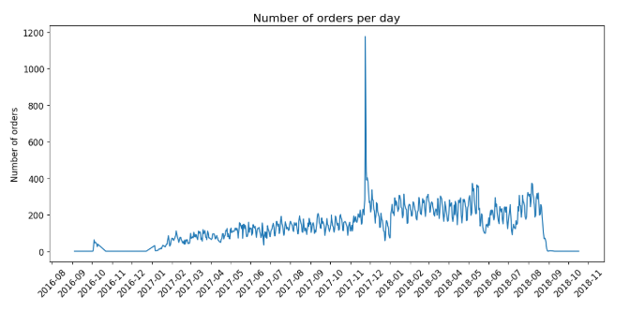
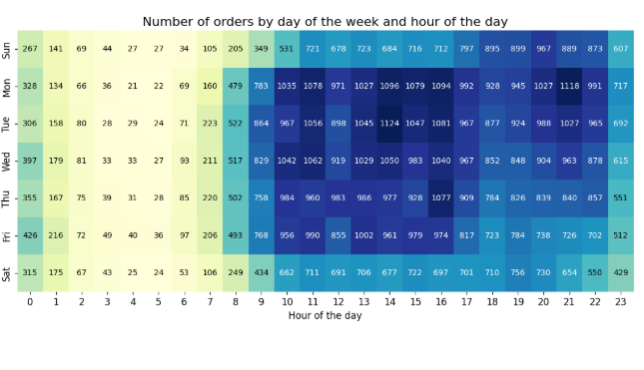

PICTURES
x
Introduction
Objectives
Codes
Plot(1)
Plot(2)
Pictures
Insert Topic Title
7:00 PM
12/26/2024

Slide 13
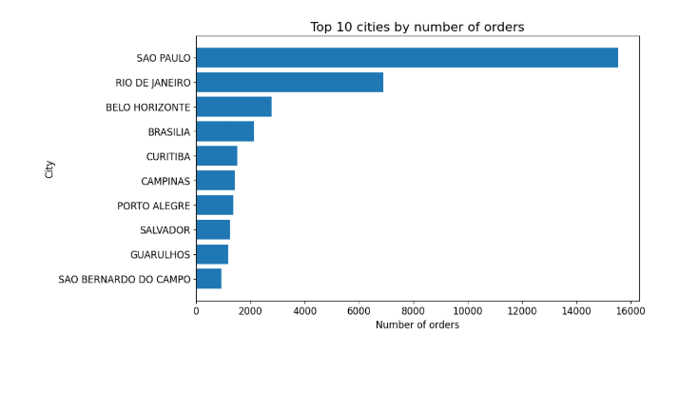
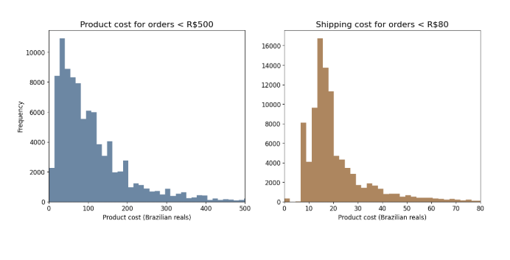
Plot(3)​
PICTURES
x
Introduction
Objectives
Plot(1)
Codes
Plot(3)
Plot(4)
Pictures
Insert Topic Title
7:00 PM
12/26/2024

Slide 14
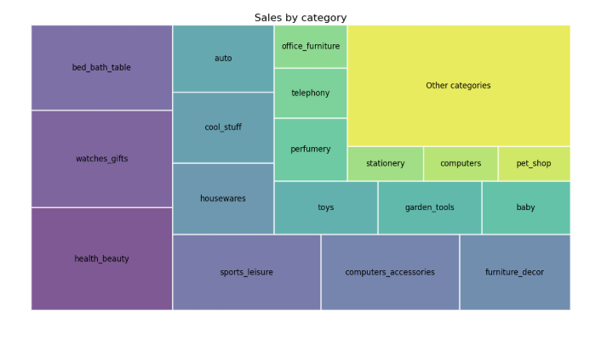
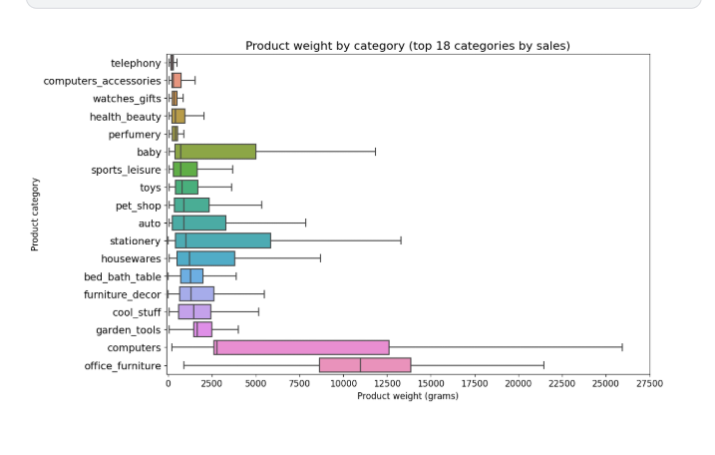
PICTURES
x
Introduction
Objectives
Codes
Plot(5)
Plot(6)
Pictures
Insert Topic Title
7:00 PM
12/26/2024

Slide 15
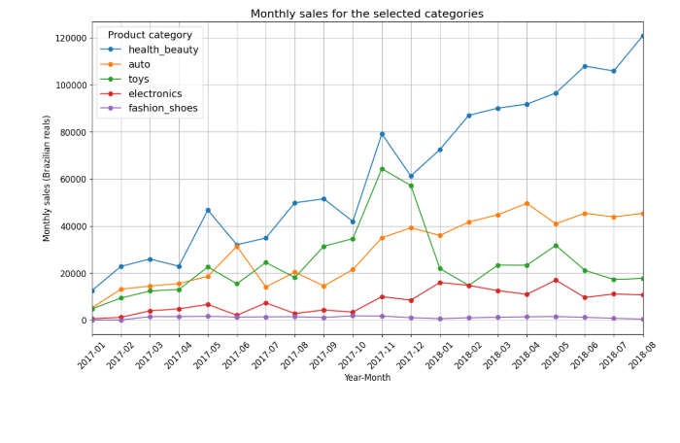
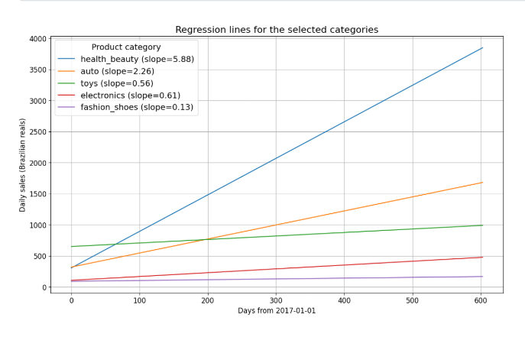
PICTURES
x
Introduction
Objectives
Codes
Plot(7)
Plot(8)
Pictures
Insert Topic Title
7:00 PM
12/26/2024

Slide 16
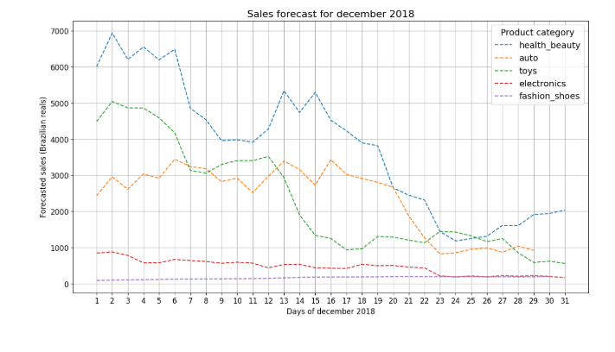
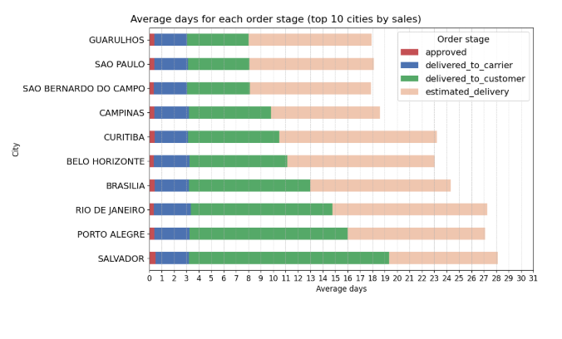
PICTURES
x
Introduction
Objectives
Codes
Plot(9)
Plot(10)
Pictures
Insert Topic Title
7:00 PM
12/26/2024

Slide 17



Introduction
Objectives
Topics
Personalize
Settings
Pictures
Shut down
Insert Topic Title
7:00 PM
12/26/2024

Slide 18
Introduction
Are you sure you want to end the presentation?
Objectives
Yes
No
Codes
Pictures
Insert Topic Title
7:00 PM
12/26/2024

Slide 19
THANK YOU FOR LISTENING!
Shutting down….

